Slide 1
CS 2600 Computer Networks I Dr. Sayeed Sajal Lecture 27 Basic Internetworking (IP)

Slide 2
Partial Spanning Tree Example (1 of 9; ref. text pp. 196 - 200 & Fig. 3.10)
I’m the root
1. B2 starts up first, claims to be the root, and multicasts the following BPDU onto LAN C (and E):
Root ID = B2 (me), 0 hops to root, My ID = B2
2. B2’s ID (2) is lower than B3’s, so B3 accepts B2 as the root (for now).

Slide 3
Selecting Root Ports (2 of 9)
B2 is root, 1 hop away
R
R
3. B3 sets its distance to the root (B2) to reflect the B3 perspective (add 1 hop), sets its LAN C port as its root port R, and multicasts this BPDU up to LAN A:
Root ID = B2, 1 hop to root, My ID = B3
B5 will receive this on LAN A, assume that B2 is root, and set its LAN A port to be a root port as well, with a distance to root of 2 hops.

Slide 4
Changing the Root Bridge (3 of 9)
R
R
B1 is root, 1 hop away
R
I’m the root
4. Meanwhile, B2 has received a BPDU from B1 on LAN E that looks like this:
Root ID = B1, 0 hops to root, My ID = B1
B2 accepts B1 as root because the B1 ID is lower than B2. B2 sets its LAN E
port to be the root port and multicasts this updated BPDU onto LAN C, where it is received by B3:
Root ID = B1, 1 hop to root, My ID = B2

Slide 5
Changing the Root Port on B5 (4 of 9)
B1 is root, 1 hop away
R
R
R
I’m the root
R
5. Similarly, B5 receives the following BPDU from B1 on LAN D, and accepts B1
as the root.
Root ID = B1, 0 hops to root, My ID = B1
As a result, B5’s root port must change from its LAN A port to its LAN D port. So B5 sends the following BPDU over LAN A to B3:
Root ID = B1, 1 hop to root, My ID = B5

Slide 6
Breaking a Root Port Tie on B3 (5 of 9)
R?
R
R
6. B3 already knows that B1 is the root, but now it knows from the BPDUs received from B2 and B5 that there are two equal cost paths to the root. B3 will break that tie by choosing the neighbor with the lower bridge ID (B2). So B3’s root port doesn’t change.
Now let’s see how the designated ports are selected for the LANs in this loop…

Slide 7
Choosing the Designated Port & Bridge on LAN A (6 of 9)
D
R
R
R
7. Here again, the timing may vary. Assume that the two bridges on LAN A select LAN A’s designated bridge and designated port by comparing each other’s BPDUs. B5 has a shorter (1-hop) root path than B3, so the downstream (furthest from the root) port on B5 becomes the designated port D on LAN A, and B5 becomes the designated bridge (on LAN A).

Slide 8
Choosing LAN C, D & E’s Designated Ports & Bridges (7 of 9)
D
R
D
R
R
D
D
8. Similarly, B2’s downstream port becomes the designated port for LAN C. B1’s ports become designated ports on LAN D and LAN E. So B1, B2 and B5 are designated bridges on at least one LAN.
Now that we have designated ports (and designated bridges) for all LANs in the
loop, we apply the rules to block redundant ports…

Slide 9
Rules for Blocking Redundant Ports (8 of 9)
D
R
D
R
R
D
D
9. First, all ports that are not root ports or designated ports are blocked (B3’s LAN A port). Then we block any “orphaned” root ports on bridges that don’t have designated ports (B3’s LAN C root port).

Slide 10
The Completed Spanning Tree (9 of 9)
D
R
D
D
R
D
R
R
D
D
Stub
LANs
D
Transit LANs
D
D
R
R
D
D
Similar processes in other parts of the graph will result in removal of all loops.
This is the spanning tree after the same techniques have been applied to the
remainder of the graph.

Slide 11
Limitations of the Spanning Tree Protocol
With all of the loops removed, alternate paths aren't available for routing frames around a congested switch
Without alternate paths, we can’t do load leveling, which means dividing the traffic associated with a heavily used connection across several different paths
Most importantly, Spanning Tree doesn’t scale
In a large spanning tree, lots of traffic will flow through the root
As the spanning tree grows, the root ultimately becomes a bottleneck

Slide 12
Slide 12
The Seventh Principle of Network Design
“Centralization is the enemy of scalability”

Slide 13
Keys to Solving the Scaling Problem
The OSI model won’t work – there’s essentially no internetworking capability, and no single network can scale up to serve the whole planet
The Internet model offers an alternative – connect lots of different networks together (“inter-net”)
But these networks are dissimilar (datagram vs. virtual circuit, different frame formats and sizes, reliable vs. unreliable, synchronous vs. asynchronous, wire vs. optical vs. wireless, etc.)
To get these heterogeneous networks talking, we need some sort of universal “adapter”
We’ll also need a system for navigating (routing) across all of these heterogeneous networks, but it can’t be dependent on any of the underlying networks – it must sit above the individual networks and be independent of them. MAC addresses won’t work for this because different networks uses different formats.
The Internet Protocol (IP) solves these problems in a remarkably straightforward fashion, at the cost of some administrative overhead

Slide 14
Internetworking Terminology

Slide 15
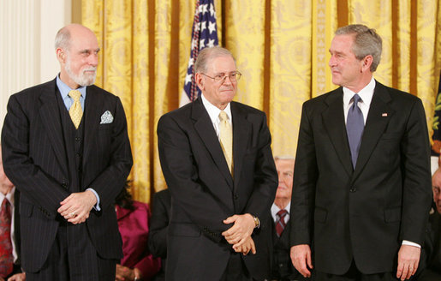
Vint Cerf and Bob Kahn, “Fathers of the Internet”
Cerf and Kahn have been awarded the following honors (among many):
National Medal of Technology by President Bill Clinton in 1997
ACM Turing Award in 2004 (considered the “Nobel Prize” in Computer Science)
Presidential Medal of Freedom by President George W. Bush in 2005
Japan Prize for Information Communication Theory and Technology in 2008

Slide 16
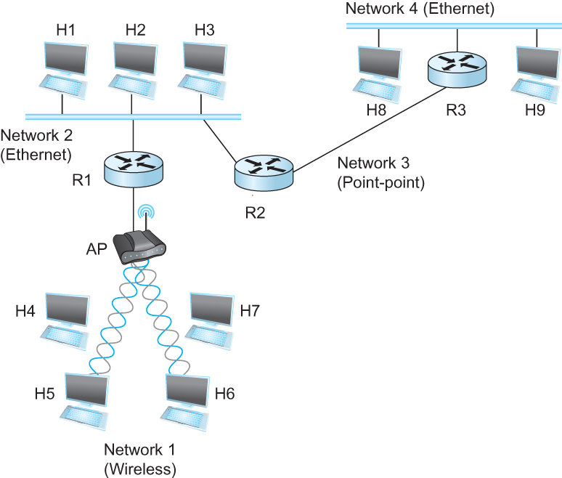
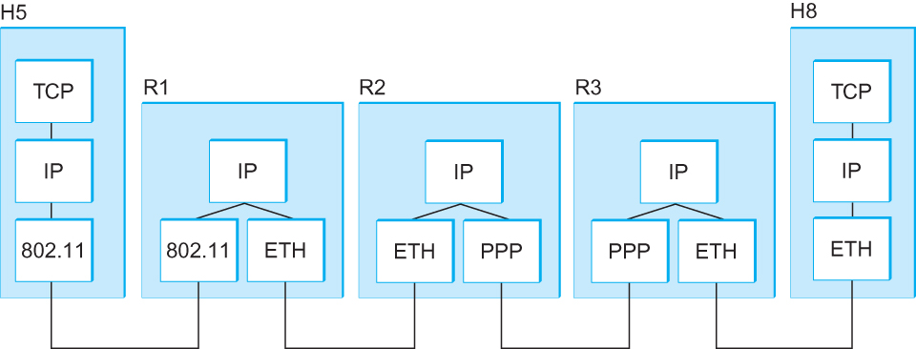
A Simple Internetwork and Associated Protocol Layers (Based on Figure 3.14)
TCP or UDP
A simple internetwork. Hn = host; Rn = router.
WiFi (Bridged)
Layer
3
2
1
TCP &
UDP
TCP &
UDP
Network 1
(WiFi)
WiFi
ETH
Figure 3.15 A simple internetwork, showing the protocol layers used to connect
H5 to H8 in Figure 3.14. ETH is the protocol that runs over the Ethernet.

Slide 17
IP as the “Common Denominator”

Slide 18
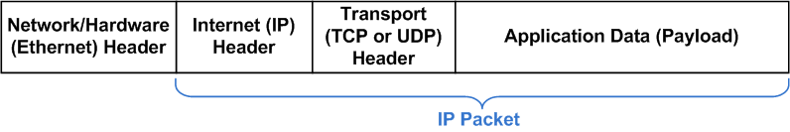
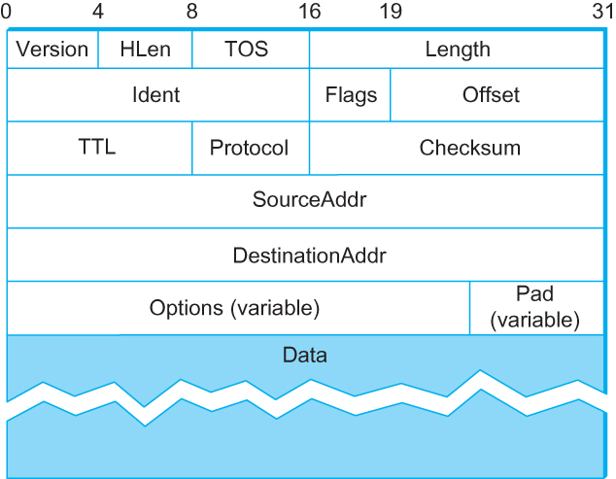
Figure 3.16 IPv4 Packet Header (RFC 791)
Ethernet Frame
Layer: 1 2 3 4
Bit:
HLen (x4)
*
(Overall IP Packet) Length
Protocol
(TCP=6 UDP=17)
20
Bytes
(Transport Header)
(Application Data)
*Redefined as Differentiated Services (“DiffServ”)

Slide 19
Differentiating Between IP and Hardware-Level Addresses
Example HW/MAC Addr: 00:15:d2:c3:23:2e Example IPv4 Addr: 161.28.11.131

Slide 20
Quiz Next Time
Covers text pages 169 - 216 which includes 4G LTE and 5G, datagram and virtual circuit concepts, ATM, bridging, switching, Spanning Tree, and IP (Lectures 24 - 27).

Slide 21
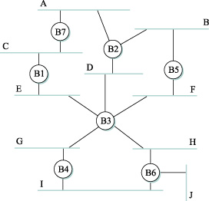
Homework Question 13.
13. Given the extended LAN shown in Figure 3.48 (shown below), indicate with an “X” which ports are disabled by the spanning tree algorithm. Show all root ports (with an “R”) and designated ports (“D”) as well. Your solution may be neatly hand drawn and scanned (or photographed), but must be submitted to Canvas, as usual. (10 points)
Figure 3.48

